Slide 1
Lecture Title: Shortest Path Algorithms
Course Code: CSC 2211
Course Title: Algorithms
Dept. of Computer Science
Faculty of Science and Technology
Lecture No: | 12 | Week No: | 12 | Semester:
Lecturer: | Name & email: Pritam Khan Boni, Pritam.khan@aiub.edu

Slide 2
Lecture Outline
Shortest Path
Dijkstra’s Algorithm
Bellman-Ford’ Algorithms
Floyd-Warshall’s Algorithm

Slide 3
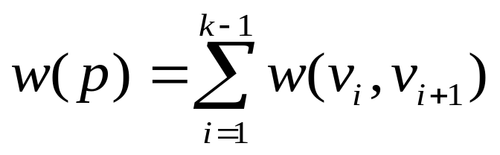
Shortest Path
Generalize distance to weighted setting
Digraph G = (V, E) with weight function W : E → R (assigning real values to edges)
Weight of path p = v₁ → v₂ → … → v_{k} is
Shortest path = a path of minimum weight (cost)
Applications
  static/dynamic network routing
  robot motion planning
  map/route generation in traffic
Shortest Path → <number>

Slide 4
Shortest-Path Problems
Shortest-Path problems
  Single-source (single-destination). Find a shortest path from a given source (vertex s) to each of the vertices.
  Single-pair. Given two vertices, find a shortest path between them. Solution to single-source problem solves this problem efficiently, too.
  All-pairs. Find shortest-paths for every pair of vertices. Dynamic programming algorithm.
  Unweighted shortest-paths – BFS.
Shortest Path → <number>

Slide 5

Optimal Substructure
Theorem: subpaths of shortest paths are shortest paths
Proof:
  if some subpath were not the shortest path, one could substitute the shorter subpath and create a shorter total path
Shortest Path → <number>

Slide 6
Negative Weights and Cycles
Negative edges are OK, as long as there are no negative weight cycles (otherwise paths with arbitrary small “lengths” would be possible).
Shortest-paths can have no cycles (otherwise we could improve them by removing cycles).
  Any shortest-path in graph G can be no longer than n–1 edges, where n is the number of vertices
Shortest Path → <number>

Slide 7
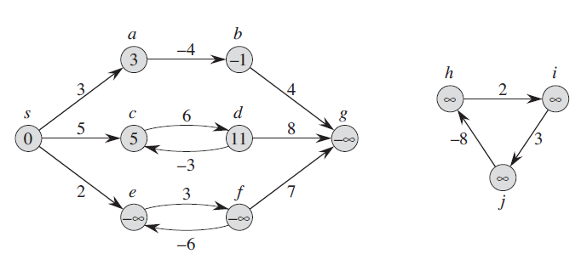
Shortest Path → <number>

Slide 8
Shortest Path Tree
The result of the algorithms is a shortest path tree. For each vertex v, it
  records a shortest path from the start vertex s to v.
  v.pred is the predecessor of v in this shortest path
  v.dist is the shortest path length from s to v
  For each vertex v in the graph, we maintain v.dist, the estimate of the shortest path from s. It is initialized to ∞ at the start.
Shortest Path → <number>

Slide 9
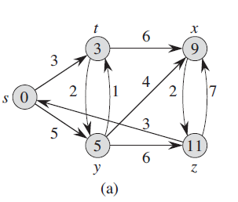
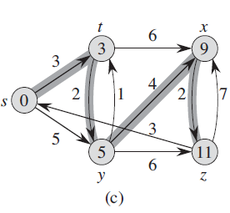
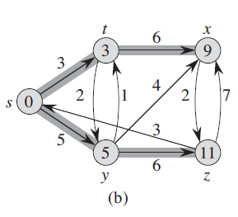
Shortest Path → <number>

Slide 10
Relaxation
Relaxing an edge (u,v) means testing whether we can improve the shortest path to v found so far by going through u.
u
v
u
v
2
2
Relax (u,v,G)
if v.dist > u.dist + w(u,v) then
v.dist := u.dist + w(u,v)
v.pred := u
5
9
5
6
Relax(u,v)
Relax(u,v)
5
7
5
6
2
2
u
v
u
v
Shortest Path → <number>

Slide 11
Dijkstra's Algorithm
Non-negative edge weights
Greedy, similar to Prim's algorithm for MST
Use Q, a priority queue with keys v.dist, which is re-organized whenever some dist decreases
Basic idea
  maintain a set S of solved vertices
  at each step select "closest" vertex u, add it to S, and relax all edges from u
Shortest Path → <number>

Slide 12
Dijkstra’s Pseudo Code
Input: Graph G, start vertex s
Dijkstra(G,s)
01 for each vertex u ∈ G.V
02 u.dist := ∞
03 u.pred := NIL
04 s.dist := 0
05 S := ∅ // S is used to explain the algorithm
06 init(Q, G.V) // Q is a priority queue
07 while not isEmpty(Q)
08 u := extractMin(Q)
09 S := S ∪ {u}
10 for each v ∈ u.adj do
11 Relax(u, v, G)
12 modifyKey(Q, v)
relaxing edges
Shortest Path → <number>

Slide 13
Dijkstra’s Example
Dijkstra(G,s)
01 for each vertex u ∈ G.V
02 u.dist := ∞
03 u.pred := NIL
04 s.dist := 0
05 S := ∅
06 init(Q, G.V)
07 while not isEmpty(Q)
08 u := extractMin(Q)
09 S := S ∪ {u}
10 for each v ∈ u.adj do
11 Relax(u, v, G)
12 modifyKey(Q, v)
u
u
u
u
u
u
v
v
v
v
v
v
1
1
1
1
1
1
8
8
8
14
13
10
9
8
∞
∞
9
10
∞
10
10
10
10
10
9
9
9
9
9
9
2
2
2
2
3
3
3
2
3
2
3
s
0
3
s
s
0
0
0
s
0
0
4
4
4
6
6
4
6
4
6
4
6
6
7
7
7
7
7
7
5
5
5
5
5
5
5
5
5
5
∞
7
7
5
7
∞
7
∞
2
2
2
2
2
2
x
x
x
y
y
x
y
x
y
x
y
y
Shortest Path → <number>

Slide 14
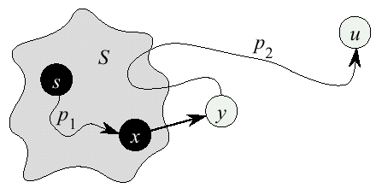
Dijkstra’s Correctness
We prove that whenever u is added to S, u.dist= δ(s,u), i.e., dist is minimum, and that equality is maintained thereafter.
Proof (by contradiction)
  Initially ∀v: v.dist ≥ δ(s,v)
  Let u be the first vertex such that there is a shorter path than u.dist, i.e., u.dist > δ(s,u)
  We will show that this assumption leads to a contradiction
Shortest Path → <number>

Slide 15
...Dijkstra Correctness
Let y be the first vertex ∈ V–S on the actual shortest path from s to u, then it must be that y.dist = δ(s,y) because
  x.dist is set correctly for y's predecessor x∈S on the shortest path (by choice of u as the first vertex for which dist is set incorrectly)
  when the algorithm inserted x into S, it relaxed the edge (x,y) , setting y.dist to the correct value
Shortest Path → <number>

Slide 16
...Dijkstra Correctness
But u.dist > y.dist ⇒ algorithm would have chosen y (from the PQ) to process next, not u
⇒ contradiction
Thus, u.dist = δ(s,u) at time of insertion of u into S, and Dijkstra's algorithm is correct
u.dist > δ(s,u) initial assumption
= δ(s,y) + δ(y,u) optimal substructure
= y.dist + δ(y,u) correctness of y.dist
≥ y.dist no negative weights
Shortest Path → <number>

Slide 17
Dijkstra’s Running Time
Extract-Min executed |V| time
Decrease-Key executed |E| time
Time = |V| T_{Extract-Min} + |E| T_{Decrease-Key}
T depends on different Q implementations
Q | T(Extract-Min) | T(Decrease-Key) | Total
array | Ο(V) | Ο(1) | Ο(V ²)
binary heap | Ο(lg V) | Ο(lg V) | Ο(E lg V)
Shortest Path → <number>

Slide 18
Bellman-Ford Algorithm
Dijkstra’s doesn’t work when there are negative edges:
  Intuition – we cannot be greedy anymore on the assumption that the lengths of paths will only increase in the future
Bellman-Ford algorithm detects negative cycles (returns false) or returns the shortest path-tree
Shortest Path → <number>

Slide 19
Bellman-Ford Algorithm
Bellman-Ford(G,s)
01 for each vertex u ∈ G.V
02 u.dist := ∞
03 u.pred := NIL
04 s.dist := 0
05 for i := 1 to |G.V()|-1 do
06 for each edge (u,v) ∈ G.E do
07 Relax (u,v,G)
08 for each edge (u,v) ∈ G.E do
09 if v.dist > u.dist + w(u,v) then
10 return false
11 return true
Relax (u,v,G)
if v.dist > u.dist + w(u,v) then
v.dist := u.dist + w(u,v)
v.pred := u
Shortest Path → <number>

Slide 20
Bellman-Ford Example
t
x
5
6
-2
-3
8
s
-4
7
2
7
9
y
z
Shortest Path → <number>

Slide 21
Bellman-Ford Example
t
x
t
x
5
5
6,s
∞,nil
∞,nil
∞,nil
6
-2
6
-2
-3
-3
0
8
0
8
s
-4
7
s
-4
7
2
2
7
7
7,s
∞,nil
∞,nil
∞,nil
9
9
y
z
y
z
After pass 1
Initialization
The order of edges examined in each pass:
(t, x), (t, z), (x, t), (y, x), (y, t), (y, z), (z, x), (z, s), (s, t), (s, y)
Shortest Path → <number>

Slide 22
Bellman-Ford Example
t
x
t
x
5
5
6,s
∞,nil
6,s
4,y
6
-2
6
-2
-3
-3
0
8
0
8
s
-4
7
s
-4
7
2
2
7
7
7,s
∞,nil
7,s
2,t
9
9
y
z
y
z
After pass 1
After pass 2
The order of edges examined in each pass:
(t, x), (t, z), (x, t), (y, x), (y, t), (y, z), (z, x), (z, s), (s, t), (s, y)
Shortest Path → <number>

Slide 23
Bellman-Ford Example
t
x
t
x
5
5
6,s
4,y
2,x
4,y
6
-2
6
-2
-3
-3
0
0
8
8
s
-4
7
s
-4
7
2
2
7
7
7,s
2,t
7,s
2,t
9
9
z
y
z
y
After pass 2
After pass 3
The order of edges examined in each pass:
(t, x), (t, z), (x, t), (y, x), (y, t), (y, z), (z, x), (z, s), (s, t), (s, y)
Shortest Path → <number>

Slide 24
Bellman-Ford Example
t
x
t
x
5
5
2,x
4,y
2,x
4,y
6
-2
6
-2
-3
-3
0
8
0
8
s
-4
7
s
-4
7
2
2
7
7
7,s
2,t
7,s
-2,t
9
9
y
z
y
z
After pass 3
After pass 4
The order of edges examined in each pass:
(t, x), (t, z), (x, t), (y, x), (y, t), (y, z), (z, x), (z, s), (s, t), (s, y)
Shortest Path → <number>

Slide 25
Bellman-Ford Time Complexity
Bellman-Ford(G, w, s)
Initialize-Single-Source(G, s)
for i := 1 to |V| - 1 do
for each edge (u, v) ∈ E do
Relax(u, v, w)
for each vertex v ∈ u.adj do
if d[v] > d[u] + w(u, v)
then return False // there is a negative cycle
return True
Time complexity: O(|V||E|)
Shortest Path → <number>

Slide 26
Correctness of Bellman-Ford
Let δ_{i}(s,u) denote the length of path from s to u, that is shortest among all paths, that contain at most i edges
Prove by induction that u.dist = δ_{i}(s,u) after the i^{th} iteration of Bellman-Ford
  Base case (i=0) trivial
  Inductive step (say u.dist = δ_{i-1}(s,u)):
    Either δ_{i}(s,u) = δ_{i-1}(s,u)
    Or δ_{i}(s,u) = δ_{i-1}(s,z) + w(z,u)
    In an iteration we try to relax each edge ((z,u) also), so we handle both cases, thus u.dist = δ_{i}(s,u)
Shortest Path → <number>

Slide 27
Correctness of Bellman-Ford
After n-1 iterations, u.dist = δ_{n-1}(s,u), for each vertex u.
If there is still some edge to relax in the graph, then there is a vertex u, such that δ_{n}(s,u) < δ_{n-1}(s,u). But there are only n vertices in G – we have a cycle, and it is negative.
Otherwise, u.dist = δ_{n-1}(s,u) = δ(s,u), for all u, since any shortest path will have at most n-1 edges
Shortest Path → <number>

Slide 28
Shortest-Path in DAG’s
Finding shortest paths in DAG’s is much easier, because it is easy to find an order in which to do relaxations – Topological sorting!
Running time:
  Θ(V+E) – only one relaxation for each edge, V times faster than Bellman-Ford
DAG-Shortest-Paths(G,w,s)
01 01 for each vertex u ∈ G.V
02 u.dist := ∞
03 u.pred := NIL
04 s.dist := 0
05 topologically sort G
06 for each vertex u taken in topological order do
07 for each v ∈ u.adj do
08 Relax(u, v, G)
Shortest Path → <number>

Slide 29
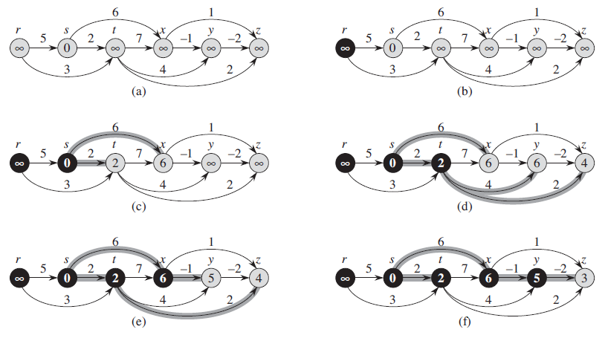
Shortest Path → <number>

Slide 30

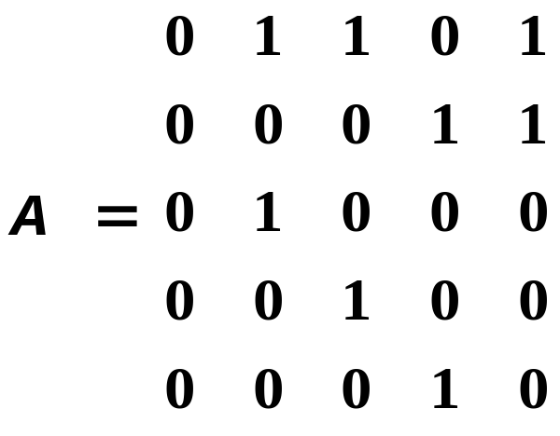
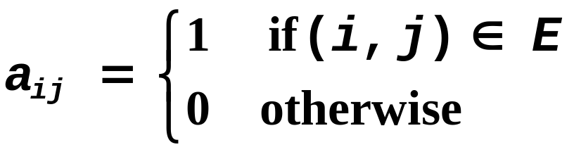
All Pair Shortest Path
G(V,E) is a directed graph in its adjacency matrix representation.
The adjacency matrix representation is of size
2
1
3
5
4
Shortest Path → <number>

Slide 31
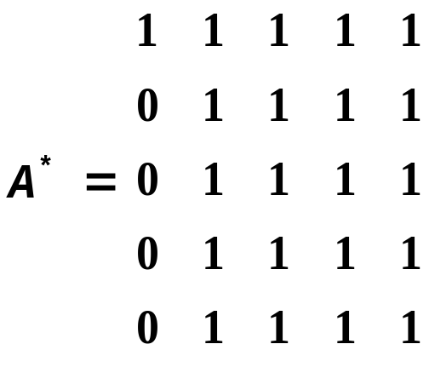
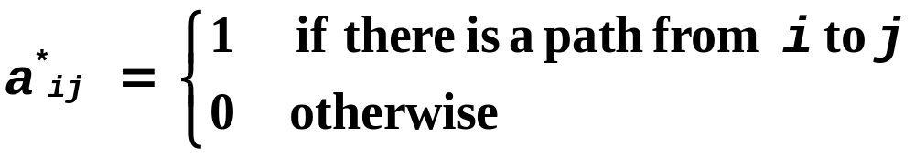
All Pair Shortest Path
The Transitive Closure of G(V,E) is
2
1
3
5
4
Shortest Path → <number>

Slide 32
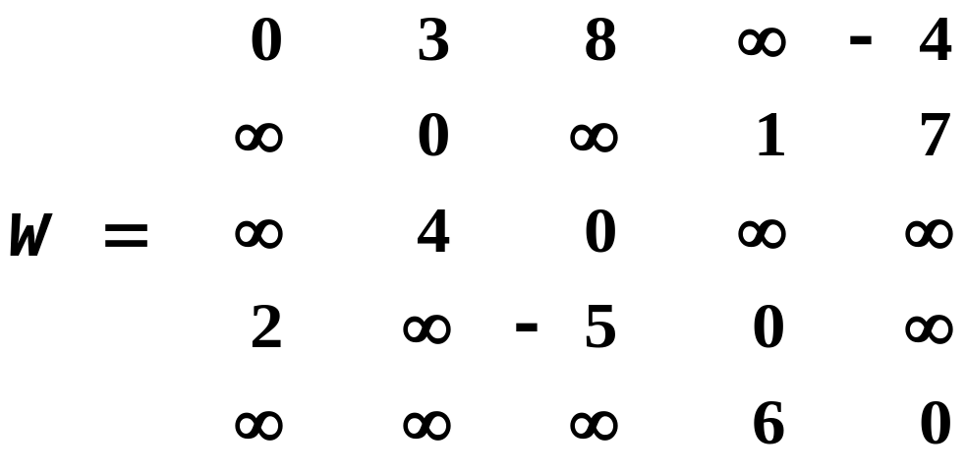
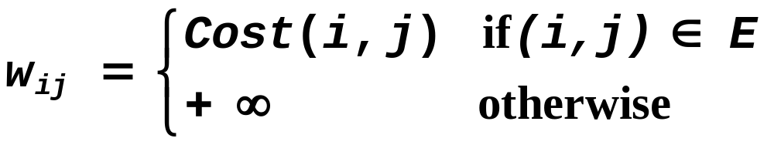
All Pair Shortest Path
G(V,E) is a directed graph in its adjacency matrix representation (initially)
2
3
4
7
1
1
3
8
-4
2
-5
5
4
6
Shortest Path → <number>

Slide 33
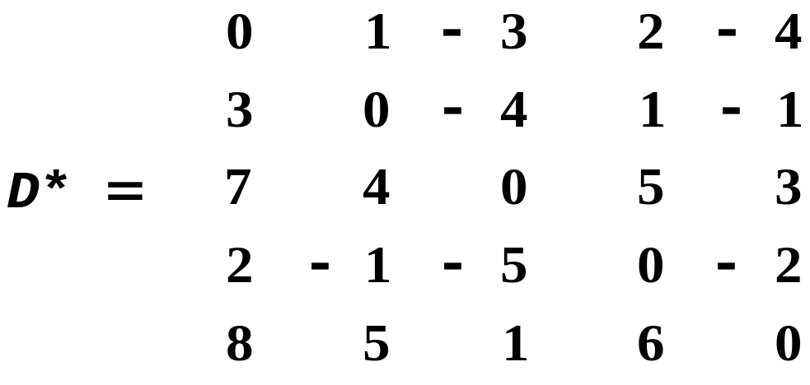
All Pair Shortest Path
Assumption: the graph has NO NEGATIVE CYCLES, otherwise the shortest distance is not well defined.
The Paths Distance Matrix of G(V,E) is
2
3
4
7
1
1
3
8
-4
2
-5
5
4
6
Shortest Path → <number>

Slide 34
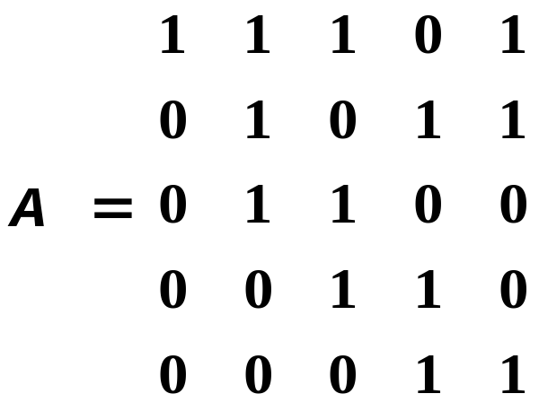
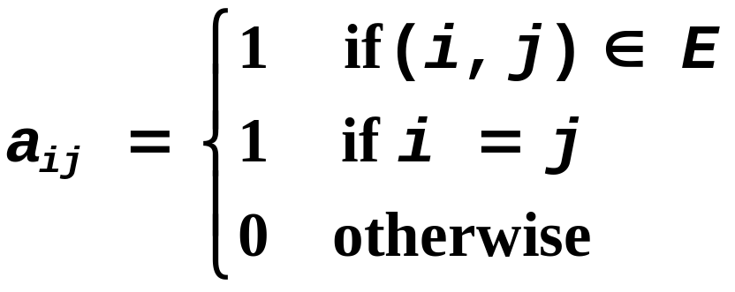
All Pair Shortest Path
Towards a transitive closure algorithm:
Insert 1’s on the diagonal of A
2
1
3
5
4
Shortest Path → <number>

Slide 35
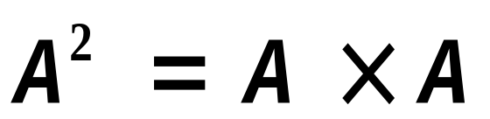
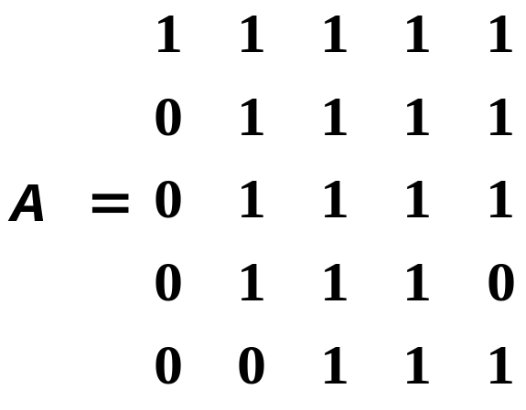
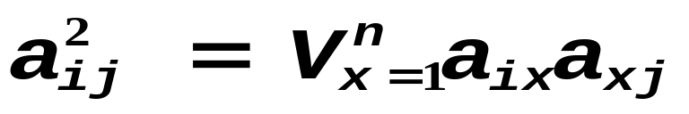
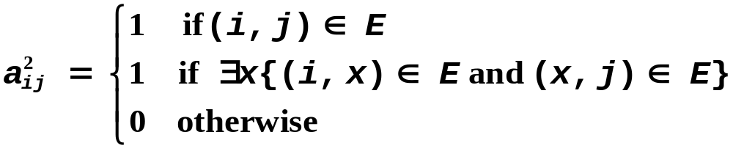
All Pair Shortest Path
Transitive closure and matrix multiplication:
What is ?
2
1
3
5
4
Shortest Path → <number>

Slide 36
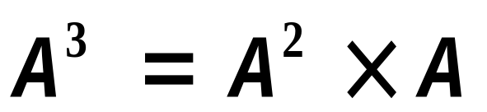
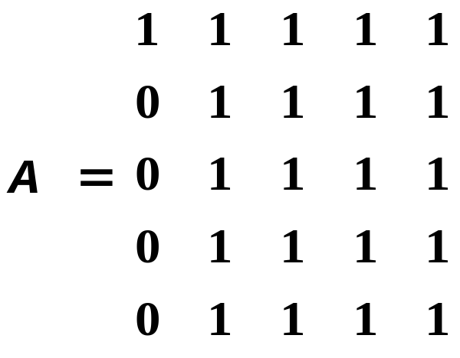
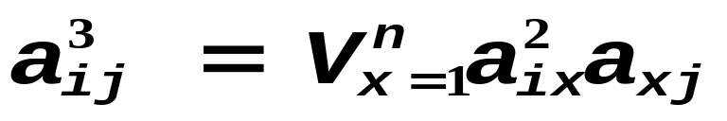
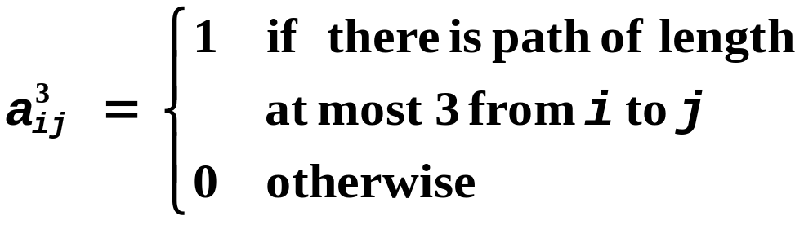
All Pair Shortest Path
Transitive closure and matrix multiplication:
What is ?
2
1
3
5
4
Shortest Path → <number>

Slide 37
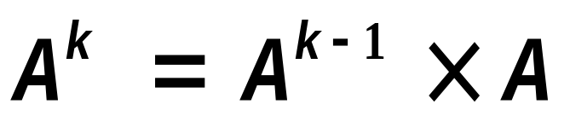
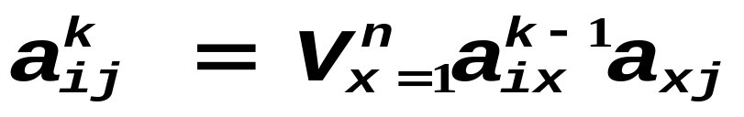
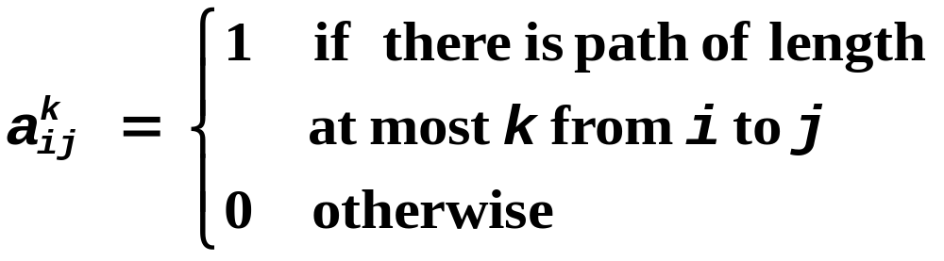
All Pair Shortest Path
Transitive closure and matrix multiplication:
What is ?
Shortest Path → <number>

Slide 38
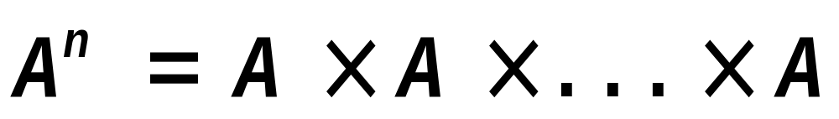
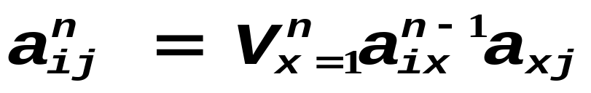
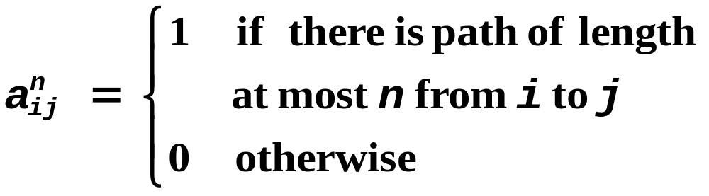
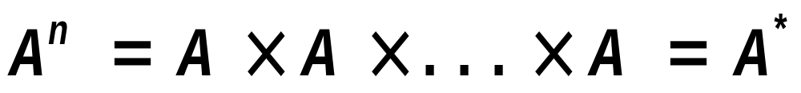
All Pair Shortest Path
Transitive closure and matrix multiplication:
What is ?
Shortest Path → <number>

Slide 39
All Pair Shortest Path
What is the complexity of multiplying two n x n matrices?
→ O(n³)
How many n x n matrix multiplications ?
→ O(n)
Total → O(n⁴)
Can We do Better ?
Shortest Path → <number>

Slide 40
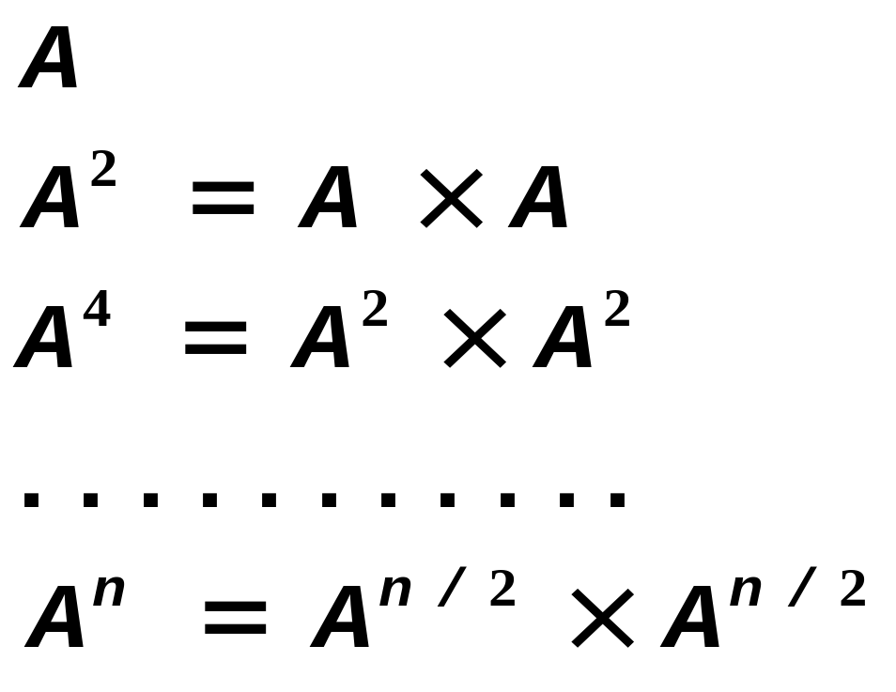

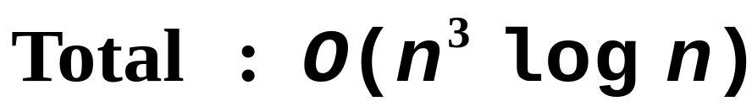
All Pair Shortest Path
Can We do Better ?
Shortest Path → <number>

Slide 41
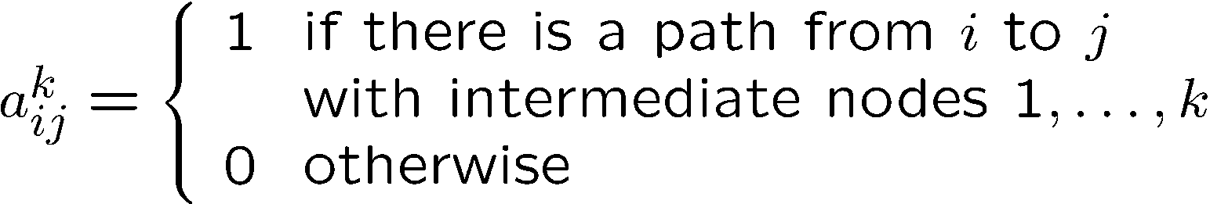

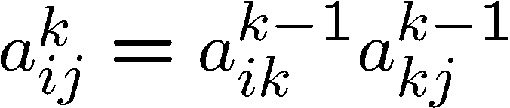


All Pair Shortest Path
ANOTHER DEFINITION
K-1
nodes
1
nodes
1
K-1
Shortest Path → <number>

Slide 42
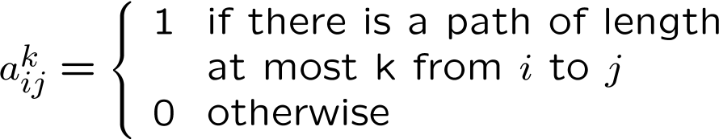

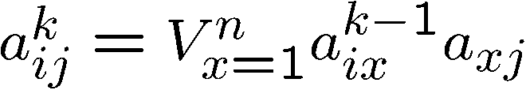


All Pair Shortest Path
FIRST DEFINITION
SECOND DEFINITION
1
K-1
nodes
nodes
1
K-1
Shortest Path → <number>

Slide 43







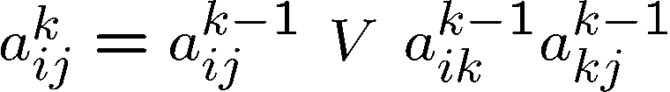

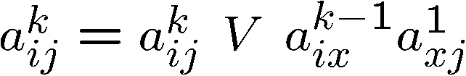
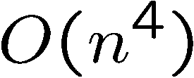
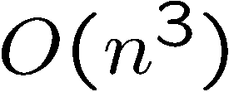
All Pair Shortest Path
FIRST DEFINITION
SECOND DEFINITION
Shortest Path → <number>

Slide 44
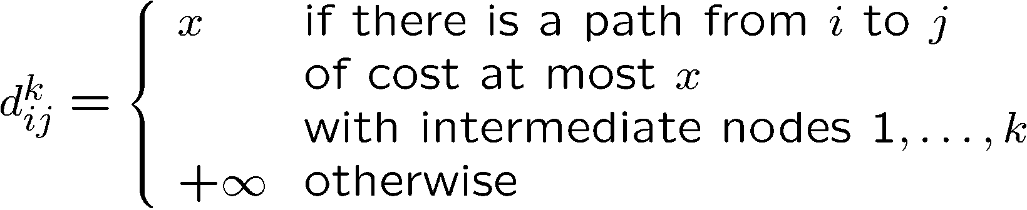




All Pair Shortest Path
K-1
nodes
1
nodes
1
K-1
K-1
1
nodes
Shortest Path → <number>

Slide 45
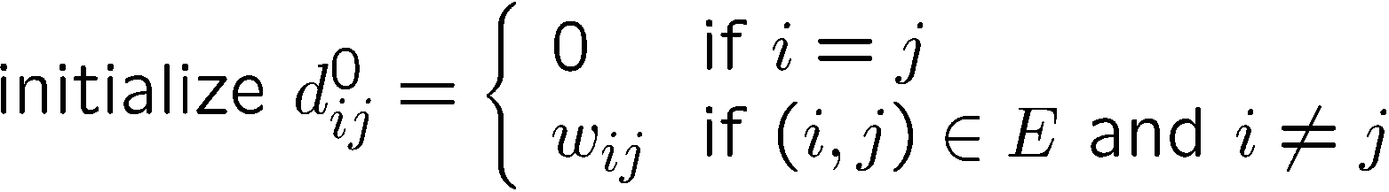



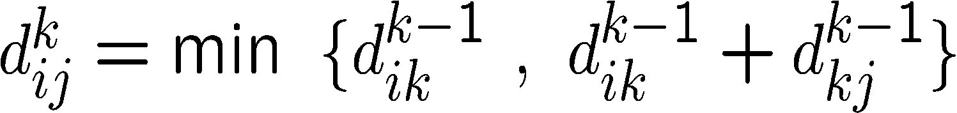
All Pair Shortest Path, Floyd-Warshall Algorithm
Shortest Path → <number>

Slide 46
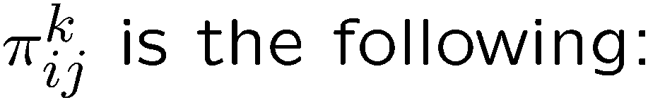
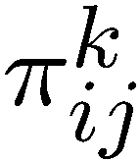
All Pair Shortest Path, Floyd-Warshall Algorithm
PREDECESSOR MATRIX
Shortest Path → <number>

Slide 47
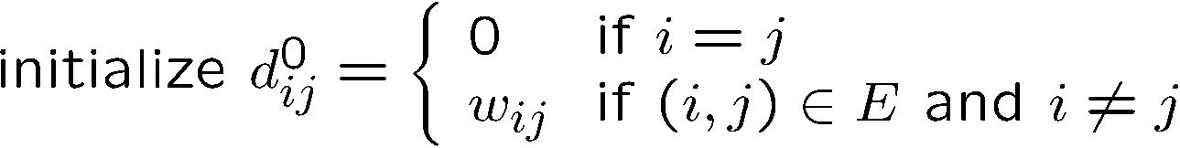
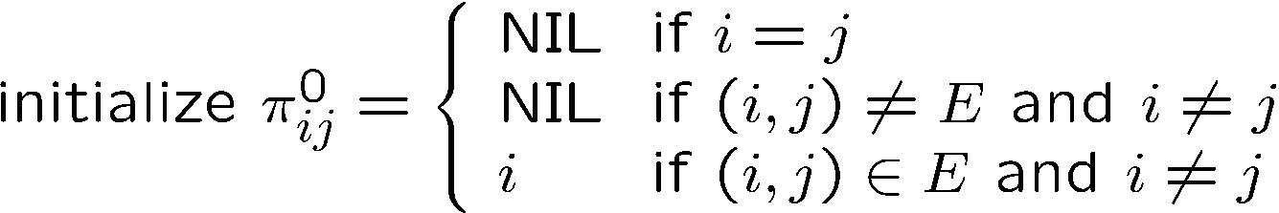
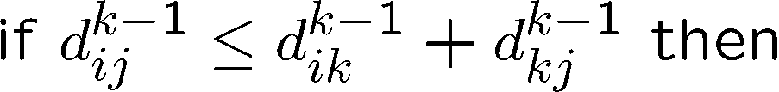
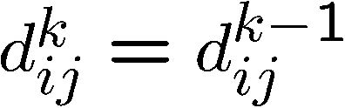




All Pair Shortest Path, Floyd-Warshall Algorithm
Shortest Path → <number>

Slide 48


All Pair Shortest Path, Floyd-Warshall Algorithm
2
3
4
7
1
1
3
8
-4
2
-5
5
4
6
Shortest Path → <number>

Slide 49


All Pair Shortest Path, Floyd-Warshall Algorithm
1
2
3
4
7
1
1
1
3
8
-4
2
-5
5
4
6
Shortest Path → <number>

Slide 50
All Pair Shortest Path, Floyd-Warshall Algorithm
2
2
3
4
7
1
1
3
8
-4
2
-5
5
4
6
Shortest Path → <number>

Slide 51
All Pair Shortest Path, Floyd-Warshall Algorithm
3
2
3
4
7
1
1
3
8
-4
2
-5
5
4
6
Shortest Path → <number>

Slide 52


All Pair Shortest Path, Floyd-Warshall Algorithm
2
4
3
4
7
1
1
3
8
-4
2
-5
5
4
6
Shortest Path → <number>

Slide 53


All Pair Shortest Path, Floyd-Warshall Algorithm
2
3
4
7
1
5
1
3
8
-4
2
-5
5
4
6
Shortest Path → <number>

Slide 54


All Pair Shortest Path, Floyd-Warshall Algorithm
1
2
3
4
7
1
1
3
8
-4
2
-5
5
4
6
Shortest Path → <number>

Slide 55
All Pair Shortest Path, Floyd-Warshall Algorithm
2
2
2
3
4
7
1
1
3
8
-4
2
-5
5
4
6
Shortest Path → <number>

Slide 56


All Pair Shortest Path, Floyd-Warshall Algorithm
3
2
3
4
7
1
1
3
8
-4
2
-5
5
4
6
Shortest Path → <number>

Slide 57
All Pair Shortest Path, Floyd-Warshall Algorithm
2
4
3
4
7
1
1
3
8
-4
2
-5
5
4
6
Shortest Path → <number>

Slide 58
All Pair Shortest Path, Floyd-Warshall Algorithm
2
3
4
7
1
5
1
3
8
-4
2
-5
5
4
6
Shortest Path → <number>

Slide 59


All Pair Shortest Path, Floyd-Warshall Algorithm
1
2
3
4
7
1
1
3
8
-4
2
-5
5
4
6
Shortest Path → <number>

Slide 60
All Pair Shortest Path, Floyd-Warshall Algorithm
2
2
3
4
7
1
1
3
8
-4
2
-5
5
4
6
Shortest Path → <number>

Slide 61
All Pair Shortest Path, Floyd-Warshall Algorithm
3
2
3
4
7
1
1
3
3
8
-4
2
-5
5
4
6
Shortest Path → <number>

Slide 62


All Pair Shortest Path, Floyd-Warshall Algorithm
2
4
3
4
7
1
1
3
8
-4
2
-5
5
4
6
Shortest Path → <number>

Slide 63
All Pair Shortest Path, Floyd-Warshall Algorithm
2
3
4
7
1
5
1
3
8
-4
2
-5
5
4
6
Shortest Path → <number>

Slide 64


All Pair Shortest Path, Floyd-Warshall Algorithm
1
2
3
4
7
1
1
3
8
-4
2
-5
5
4
6
Shortest Path → <number>

Slide 65


All Pair Shortest Path, Floyd-Warshall Algorithm
2
2
3
4
7
1
1
3
8
-4
2
-5
5
4
6
Shortest Path → <number>

Slide 66


All Pair Shortest Path, Floyd-Warshall Algorithm
3
2
3
4
7
1
1
3
8
-4
2
-5
5
4
6
Shortest Path → <number>

Slide 67
All Pair Shortest Path, Floyd-Warshall Algorithm
2
4
3
4
7
1
1
3
8
-4
2
-5
5
4
4
6
Shortest Path → <number>

Slide 68



All Pair Shortest Path, Floyd-Warshall Algorithm
2
3
4
5
7
1
1
3
8
-4
2
-5
5
4
6
Shortest Path → <number>

Slide 69


All Pair Shortest Path, Floyd-Warshall Algorithm
1
2
3
4
7
1
1
3
8
-4
2
-5
5
4
6
Shortest Path → <number>

Slide 70
All Pair Shortest Path, Floyd-Warshall Algorithm
2
2
3
4
7
1
1
3
8
-4
2
-5
5
4
6
Shortest Path → <number>

Slide 71
All Pair Shortest Path, Floyd-Warshall Algorithm
3
2
3
4
7
1
1
3
8
-4
2
-5
5
4
6
Shortest Path → <number>

Slide 72
All Pair Shortest Path, Floyd-Warshall Algorithm
2
4
3
4
7
1
1
3
8
-4
2
-5
5
4
6
Shortest Path → <number>

Slide 73
All Pair Shortest Path, Floyd-Warshall Algorithm
2
3
4
5
7
1
1
3
8
-4
2
-5
5
4
5
6
Shortest Path → <number>

Slide 74


All Pair Shortest Path, Floyd-Warshall Algorithm
2
3
4
7
1
1
3
8
-4
2
-5
5
4
6
Shortest Path → <number>

Slide 75
Reading Materials
CLRS
  Exercises:
    24.1-1, 24.1-2, 24.1-3. 24.2-2, 25.2-6
  Problems:
    24-3
HSR
  Examples:
    4.11, 4.12, 5.14
Shortest Path → <number>

